Slide 1
Part 3: Building an NDT for Next-Generation WLANs with Graph Neural Networks (GNNs)
Paola Soto and Miguel Camelo

Slide 2
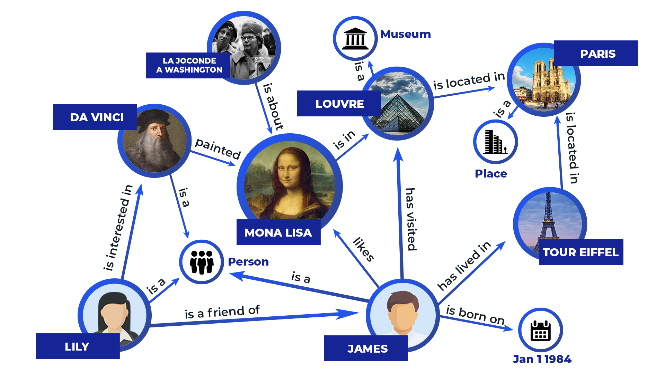
Why GNNs
GNNs are good working with relational data
Source: https://thetechbrook.com/inside-the-black-box-of-ai/
Notes:
Relational data: one sample relates to another
Extra information is carried in the topology of the graph.
Why relational data cannot be handled by CNNs? Because of its arbitrary size.

Slide 3
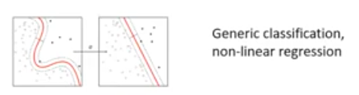
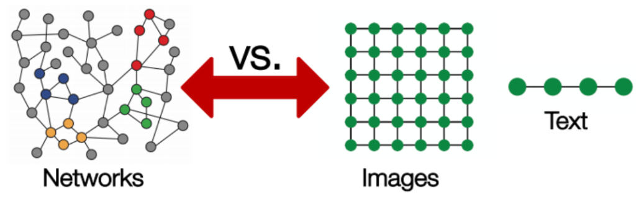
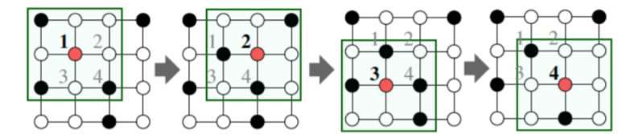
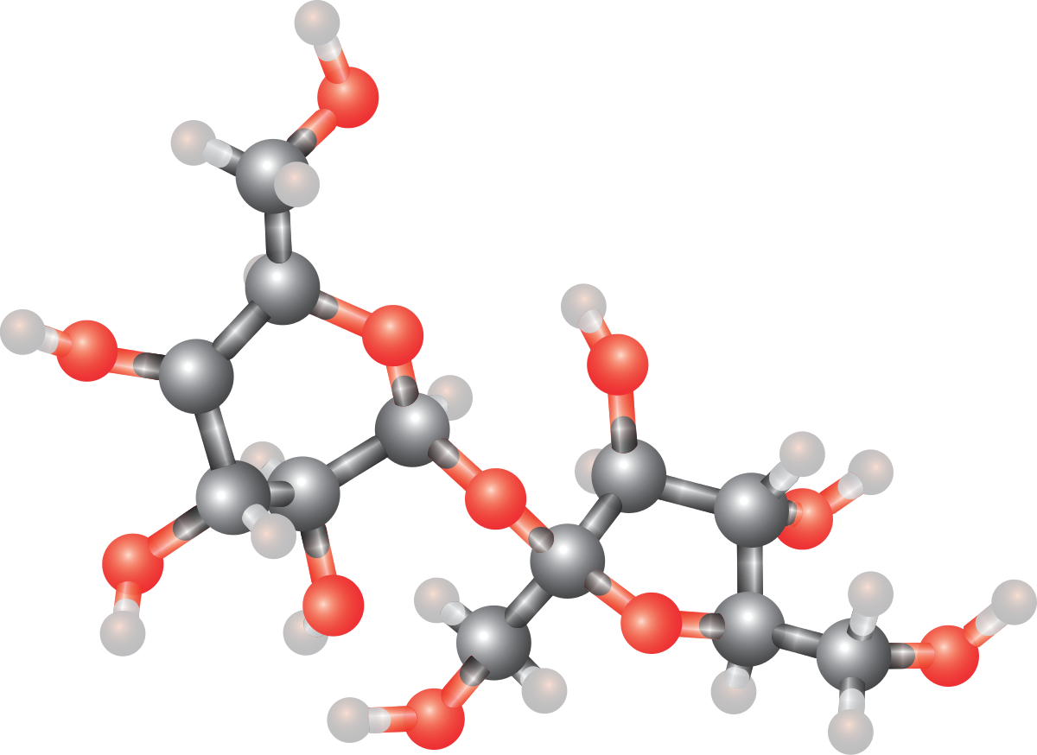
Different Neural Networks
Type of NN | Information structure
Fully Connected | Arbitrary
Convolutional | Spatial
Recurrent | Sequential
Graph | Relational
Source: https://neptune.ai/blog/graph-neural-network-and-some-of-gnn-applications
Molecules

Slide 4
Introduction to GNNs

Slide 5
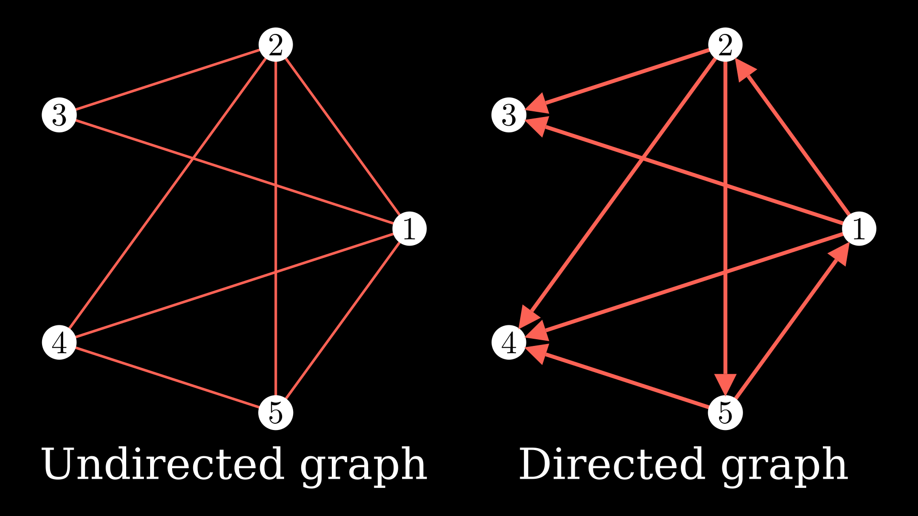
What is a graph?
A graph is 2-tuple G=(V, E) where V are the nodes and E are the links.
Each node has its own set of features.
Optionally, each link has its own set of features
Source: https://www.freecodecamp.org/news/graph-neural-networks-explained-with-examples/

Slide 6
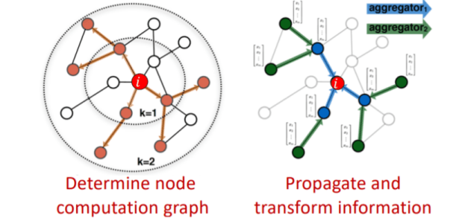
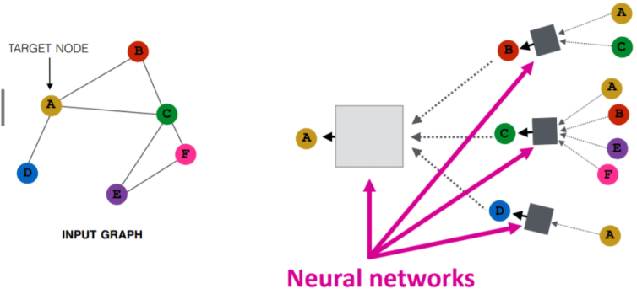
How GNNs work?
Aggregating information – Message passing
Adjacency matrix: a mathematical way to express the graph.
Exploit locality information.
Order-invariant aggregators
Sum
Average
Maximum
Source: https://neptune.ai/blog/graph-neural-network-and-some-of-gnn-applications
Notes:
The information carried by a node’s neighbohr affects the implicated node.
We need to aggregate the information from k hops to the k-1 hop.

Slide 7
GNNs for solving topology-based problems

Slide 8




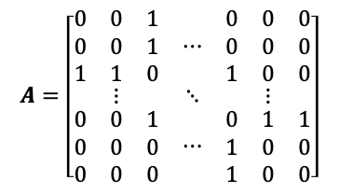

GNNs applied to WLANs
STA A1
Pos: (9.5, 15)
STA B1
Pos: (22.3, 11)
RSSI = -44dBm
Interference = -87dBm
AP A
Pos: (10, 10)
AP B
Pos: (20, 10)
2
Channels: [0,1]
Channels: [0,3]
6
$$A=\left[\begin{matrix}\begin{matrix}0 & 0 & 1 \\ 0 & 0 & 1 \\ 1 & 1 & 0\end{matrix} & ⋯ & \begin{matrix}0 & 0 & 0 \\ 0 & 0 & 0 \\ 1 & 0 & 0\end{matrix} \\ ⋮ & ⋱ & ⋮ \\ \begin{matrix}0 & 0 & 1 \\ 0 & 0 & 0 \\ 0 & 0 & 0\end{matrix} & ⋯ & \begin{matrix}0 & 1 & 1 \\ 1 & 0 & 0 \\ 1 & 0 & 0\end{matrix}\end{matrix}\right]$$
4
9
1
$$L_{i}=<l_{1}, ⋯, l_{R}>$$
3
8
$$N_{j}=<n_{1}, ⋯, n_{D}>$$
10
5
7
Access Point (AP)
Station (STA)
AP-AP Link
AP-STA Link

Slide 9
GNNs
Basic Model
Access Point (AP)
Station (STA)
AP-AP Link
AP-STA Link
GNB³: Graph Neural Block
Node attributes: node type, x-y coordinate, channel configuration
AP: mean airtime,
STA: SINR
Edge attributes: edge type, distance
AP-AP: interference
AP-STA: RSSI
Architecture
Node model
Edge model
3. P. W. Battaglia et al., “Relational inductive biases, deep learning, and graph networks,”, arXiv preprint arXiv:1806.01261, 2018

Slide 10
Hands – On

Slide 11
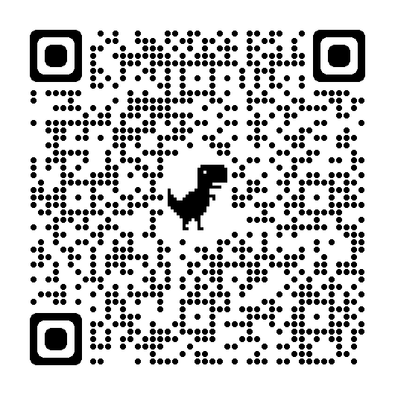
Link
Notebook: Building an NDT for next-generation WLANs using GNNs

